Slide 1



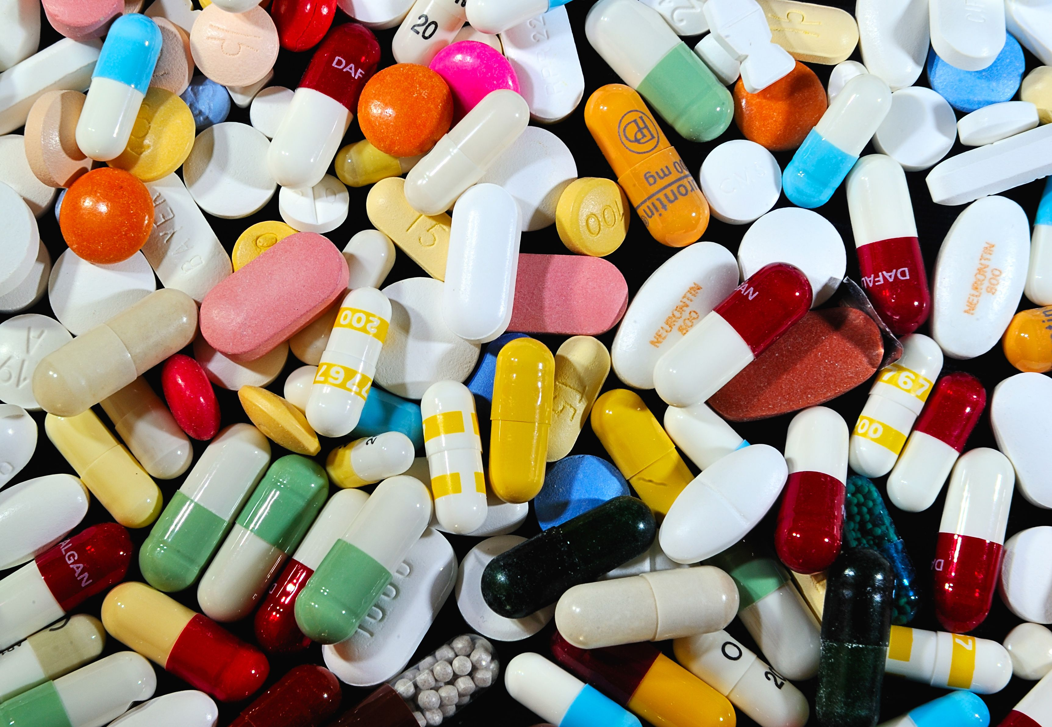
1mg

Slide 2
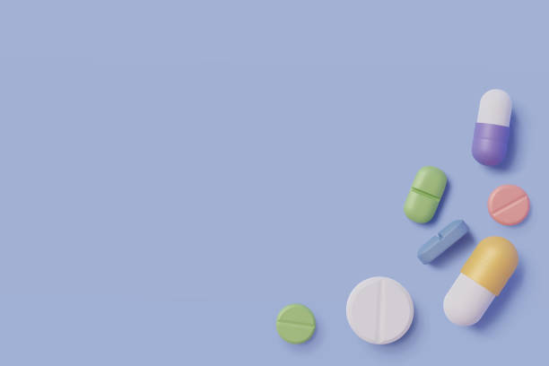

Homeopathic Medicine Analysis

Slide 3
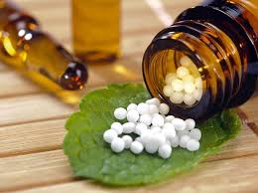
TEAM members:
Lakshay Bansal
Monika Singh Jadon
Rishabh Chugh

Slide 4
Target: Our goals towards the making of this project were---
Client - Client should have ease to choses best/needful medicines for their stores .
Dashboard - Create an interactive dashboard for client to analyze
Insights – Some insights for clients to analyze , which is good for their stores

Slide 5
Project Execution:
Scrapping (using Requests and Beautiful Soup)
Analysis and Filtering (using Excel and Python)
Dashboard / Insights

Slide 6
insights
Most sold medicine - Bakson’s fevo aid syrup
Most used ingredient – Belladonna
Most common specific area – Head
Most reviewed brand – Aaradhya sugar enterprises
Average MRP of medicine – 210 RS
Average cash generation per sale – 185 RS

Slide 7
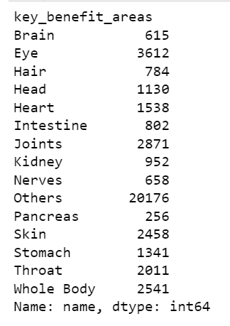
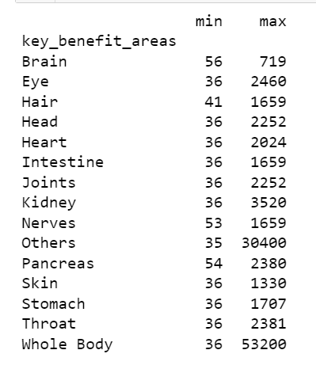
Insights
Number of medicines
PRICE RANGE

Slide 8
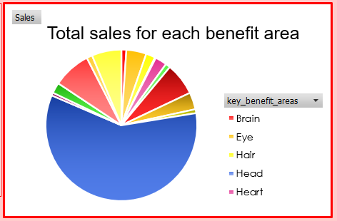
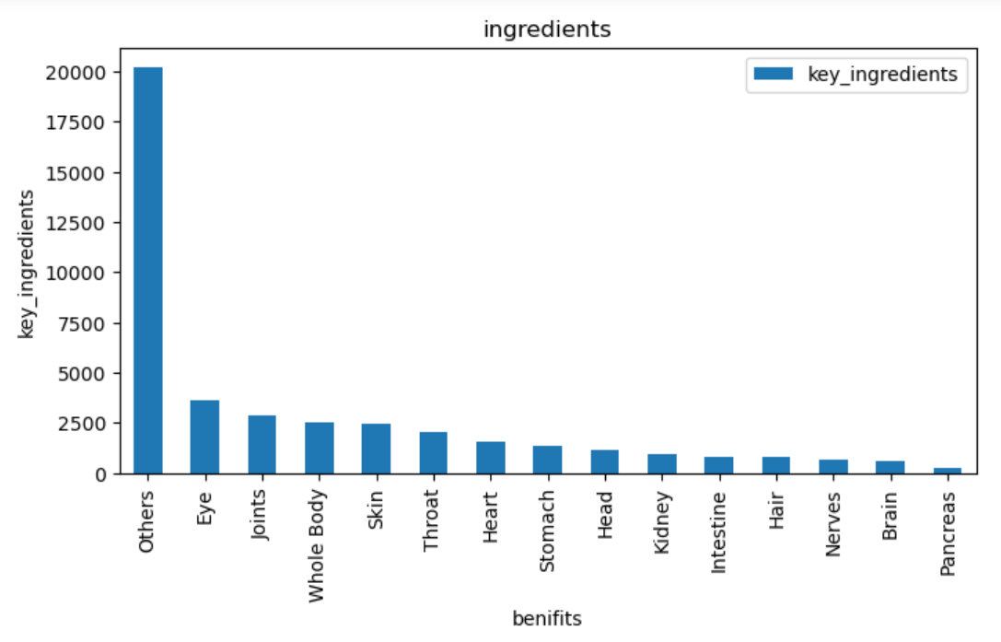

Slide 9
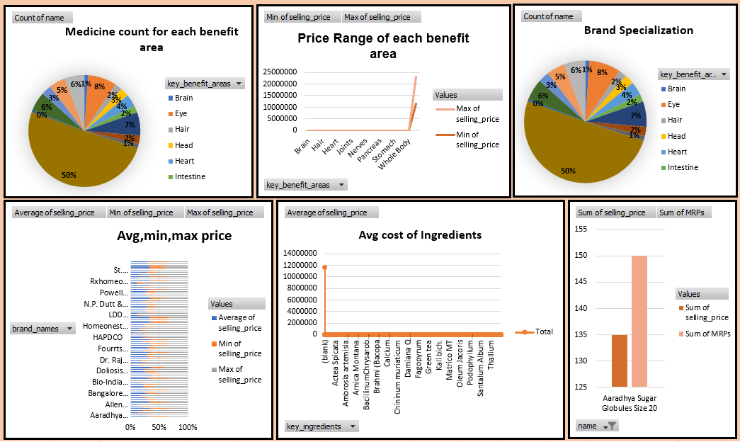
DashboarD

Slide 10
Our Approach towards the analysis:
So we obtain a result that wherever the sale of medicines for throat and head are higher, those areas are more likely to be polluted or of high population density. So, these areas could possibly be Mumbai and Delhi. So having major inventory for these two in such states could be profitable.
People from metropolitan cities such as Mumbai, Bangalore, Chennai etc. where more of civilised and corporate youth is residing, are more likely to go with medicines made with ayurvedic ingredients. So, this could be kept in mind while opting for opening a store in such cities.
If we are towards the West Indian states, states like Gujarat and Rajasthan, majority of people are vegetarian, so it is advisable to have major stock of natural medicines.

Slide 11
If we are to move to northern states, such as Haryana and Punjab, people residing there are more towards home-made desi remidies (popular as dadi ke nuskhe). So the brand needs to create a impact in those areas to make people realize that their medicines are of some value to them.
Overall there was this output that 1mg being a part of company TATA is doing good in each area. Also it has brought a revolutionizing change in the field of doorstep medical service.

Slide 12
CHALLANGES FACED DURING THE PROJECT:
LEARNING OF A NEW SKILL: WEB SCRAPPING (OPPORTUNITY AS WELL AS A CHALLANGE)
DATA WAS TOO BIG TO RETRIEVE WE GOT DISCONNECTED WITH THE COMPANY’S SERVER A NUMBER OF TIMES.
REQUIREMENT OF A STABLE NETWORK.
FACE OFF WITH A REAL LIFE PROJECT WAS CHALLANGING BUT GOT OUR HANDS ON THE TOOLS WELL.

Slide 13
THANK YOU FOR THIS OPPORTUNITY

